Slide 1
Session 5 – Discrete Choice - PyBLP Data Skills for Research Kellogg Research Support
August 16, 2023

Slide 2
What is BLP?
Models based on Berry, Levinsohn and Pakes (1995) and related papers have become ‘workhorse’ models in Empirical Industrial Organization, Marketing, Environmental Economics, Economics of Education, ….
What do these models do differently?
Discrete choice models of differentiated product demand
Tackle Price Endogeneity
Can generate realistic substitution patterns by modeling unobserved attributes / quality and allowing for preference heterogeneity
Allow computation of counterfactuals for policy analysis (mergers, tariffs, regulation,…)

Slide 3
Roadmap
Why use a BLP Framework?
What does it solve?
What are the limitations?
PyBLP to the Rescue
Tutorials
Using PyBLP on KLC
Running Tutorials
Using Knitro as an Optimization Routine
Notes:
All these things turn procedural unspoken knowledge into explicit, declarative and executable specifications

Slide 4
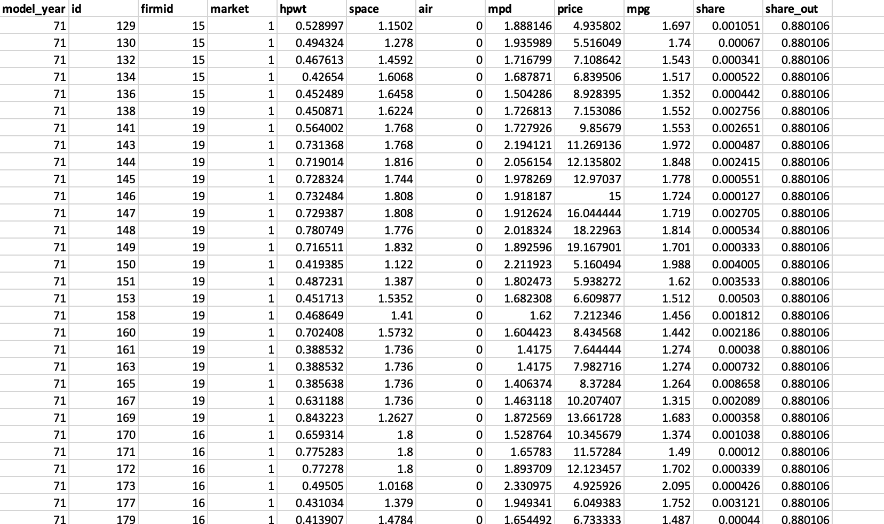
Dataset – Automobile Market 1970-1990

Slide 5
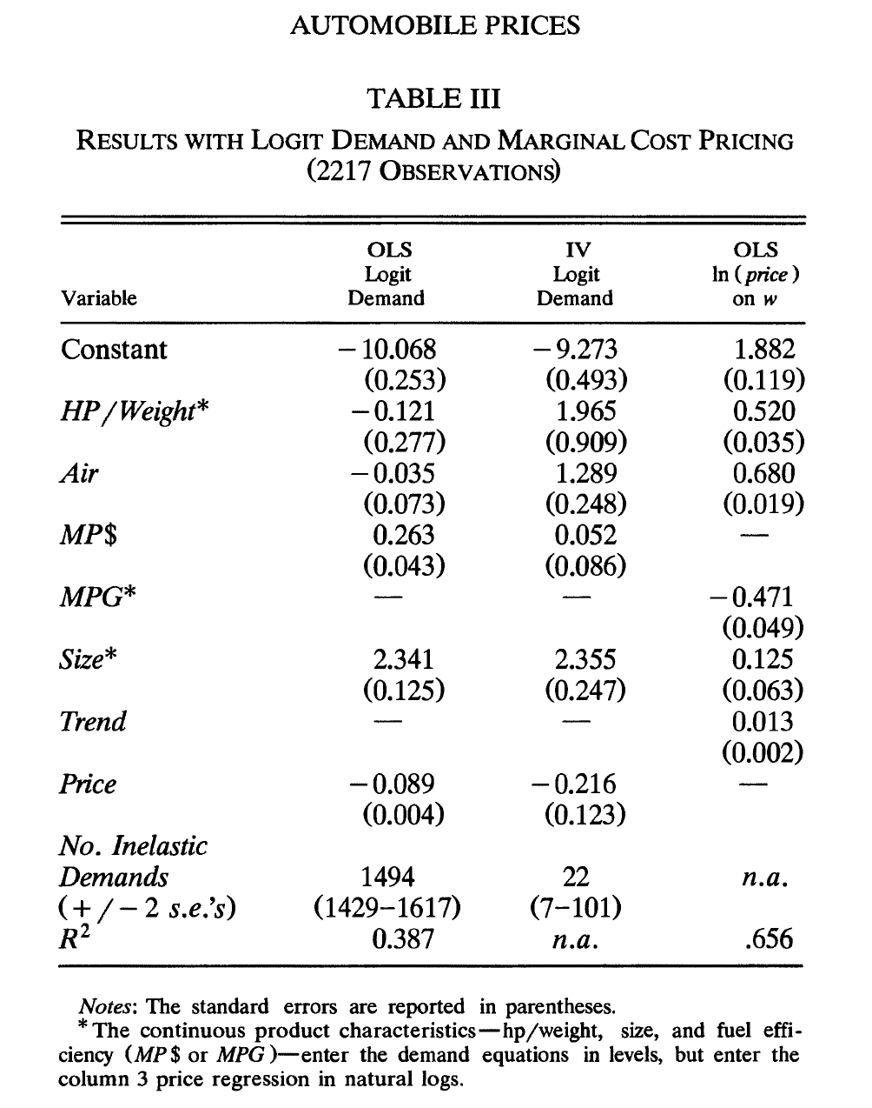
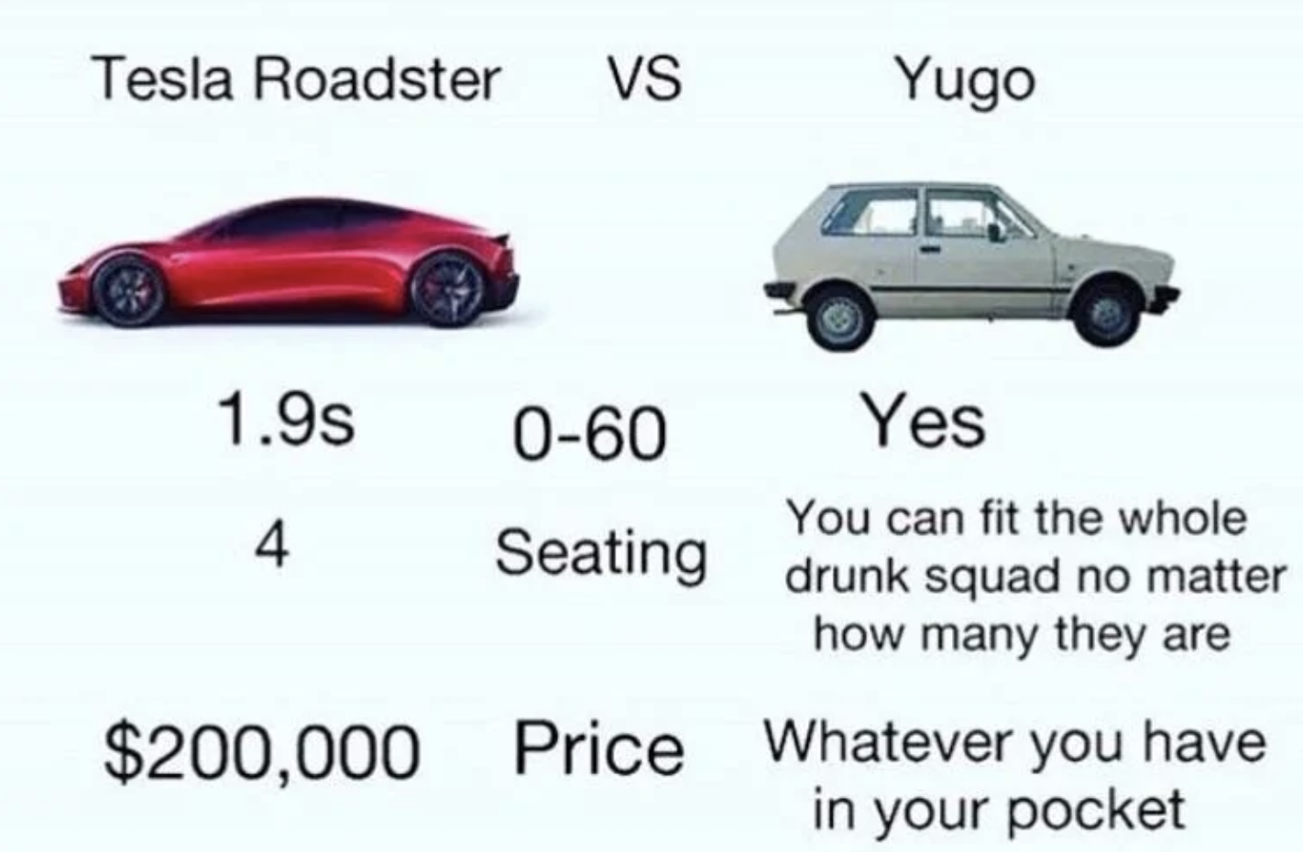
Why BLP?
Berry, Levinsohn and Pakes (1995) car sales results of a regular OLS
This model predicts that the same price increase for a BMW and Yugo would equally decrease demand.

Slide 6
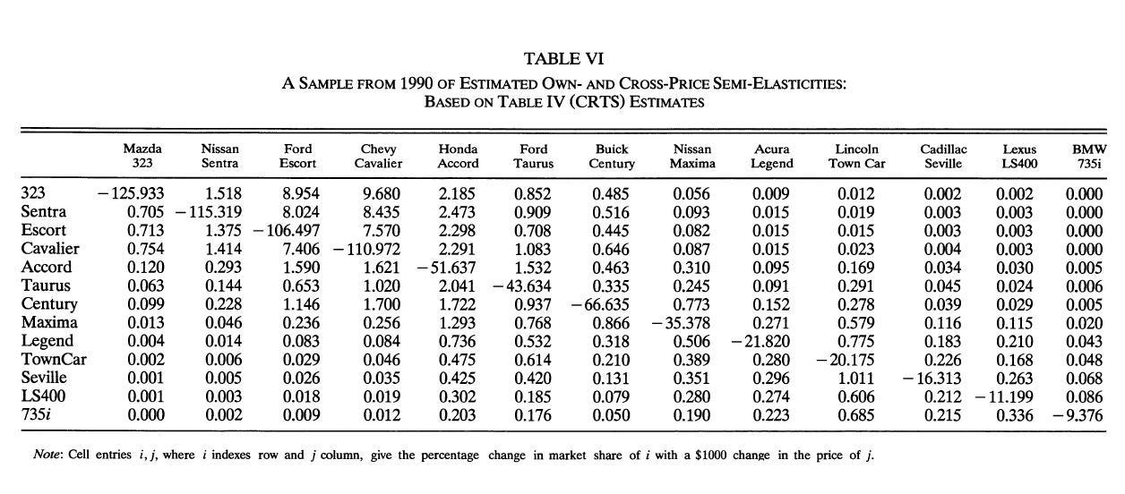
BLP fixes this!

Slide 7
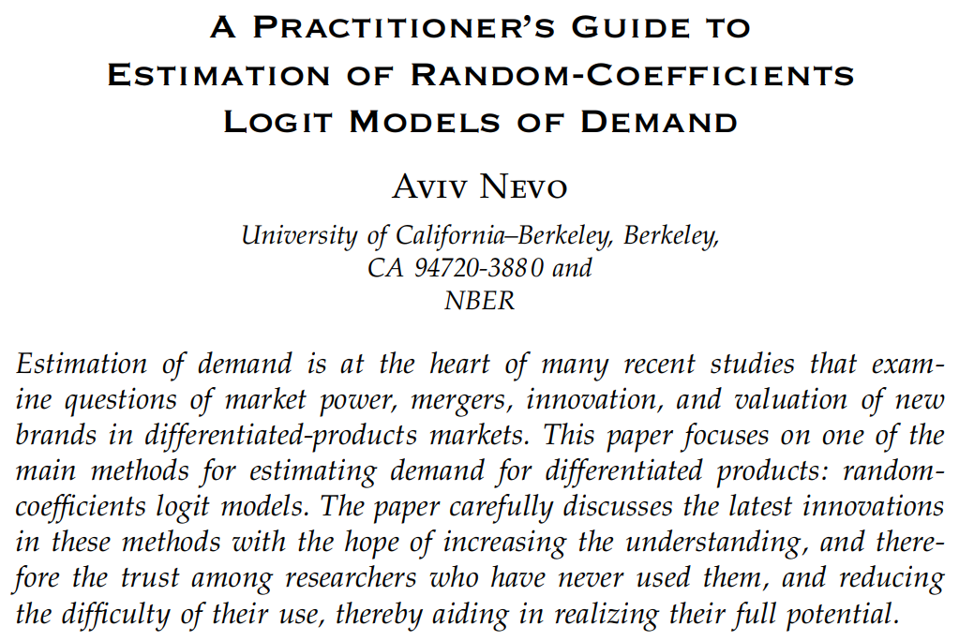
So what’s the problem? Nevo (2000)

Slide 8
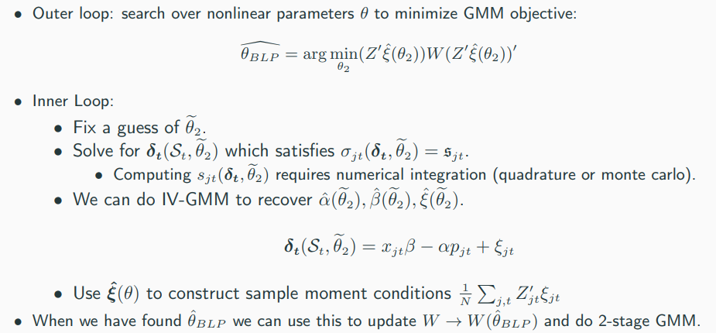
So what’s the problem?
From the econometric model to pseudocode to code

Slide 9
So what’s the problem?
From the econometric model to pseudocode to code

Slide 10
So what’s the problem? K-M 2014 (!)

Slide 11
PyBLP to the Rescue
Paper by Conlon and Gortmaker (2020) with accompanying python package
Expansive model that nests many canonical BLP-style papers
Consistent notation helps understand differences between models
Very modular – elements such as supply-side restrictions, micro moments can be added as appropriate
Using CS-inspired best practices on various subproblems appears to allay many of the Knittel-Metaxoglou (2014) concerns
Choice of free (SciPy) or commercial (Artelys Knitro) optimization routines

Slide 12
PyBLP Modified Tutorials
PyBLP offers tutorials here: https://pyblp.readthedocs.io/en/stable/tutorial.html
Today we will go through the logit, random coefficients tutorials using the supply and demand side data from the original BLP (1995) dataset.
We will also demonstrate how to apply Artelys Knitro as an optimization solver on KLC

Slide 13
Creating a PyBLP Conda Environment
The PyBLP website provides explicit instructions for installing the package. Unlike most package installations, the environment needs to have certain related packages already installed before pyblp will install properly. To create a PyBLP conda environment, first load mamba:
module load mamba
Then use mamba to install a clean python environment:
mamba create -n blp_env python=3.10
Activate the environment and load the following:
source activate blp_env
Install the related packages:
conda install -c conda-forge numpy scipy sympy patsy notebook pandas statsmodels
module load gcc/11.2.0 # this is used for statsmodels
pip install --upgrade pyhdfe
Finally, install pyblp:
pip install pyblp

Slide 14
Activating a Conda Environment
To activate the environment in the future, either load mamba:
module load mamba
OR any version of conda:
module load python-anaconda3/2019.10
Then run this line to activate the environment:
source activate pyblp_env
To leave the environment:
source deactivate pyblp_env
To output the yaml file so you can share your environment with others:
conda env export > pyblp_env.yml

Slide 15
Jupyter Notebooks on KLC
Recall that we already installed jupyter notebooks into our PyBLP environment. To open a notebook on KLC, we recommend using the default Firefox web browser that is already loaded on KLC for you. Just type:
jupyter notebook --browser = firefox

Slide 16
PyBLP with Knitro
Once you activate your pyblp environment:
source activate blp_env
Just load a Knitro module on KLC:
module load knitro/12.4
mkdir ~/python_knitro
cp -r /software/knitro/12.4/examples/Python ~/python_knitro/
cd ~/python_knitro/Python
python setup.py install
Now just run your pyblp file that uses Knitro as an optimization solver:
python blp_optimizer.py --opt_method knitro
NUIT Knitro guide for Quest here: https://services.northwestern.edu/TDClient/30/Portal/KB/ArticleDet?ID=1696

Slide 17
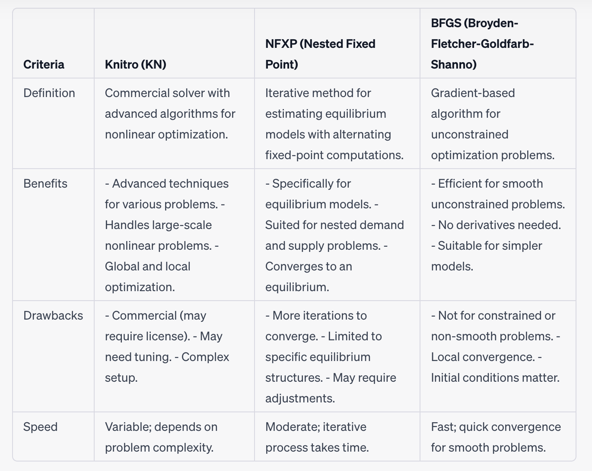
PyBLP Optimization Routine Comparison

Slide 18
PyBLP Applications
Product Pricing: Optimize prices based on market demand and competition, enhancing pricing strategies.
Market Competition: Analyze competition, mergers, and entry decisions to predict market outcomes. (See Nevo, 2001a/2001b)
Policy Evaluation: Assess policy impact on prices, consumer welfare, and industry performance. (See Bayer et al. 2007, Neilson 2017 for school choice examples)
New Product Launch: Predict market share for new products, aiding launch strategies. (see Petrin, 2002)
Consumer Behavior: Understand preferences across segments for targeted marketing.

Slide 19
Takeaways:
Versatile Estimation: One-stop solution for diverse industries, flexible model options.
Seamless Process: Data prep, estimation, equilibrium in one integrated, expandable, open-source package
Efficient Optimization: Faster convergence, accurate results with Knitro, BFGS, or default.

